Slide 1
Lawyers in Balance: Mental Health and the Work-Life Balance
Nick Tangeman, MSW LADC-S
Center for the Application of Substance Abuse Technologies
University of Nevada, Reno

Slide 2
Can You Relate?
High Demand on Time
Fast Pace
High Demand on Performance
Heavy Caseloads
High Need for Perceived Competence
Feeling Like You’re Not Making a Difference

Slide 3
“Burnout”
Exhaustion
Depersonalization or Cynicism
Lack of Accomplishment or Efficacy

Slide 4
Can You Relate?
High Demand on Time
Fast Pace
High Demand on Performance
Heavy Caseloads
High Need for Perceived Competence
Feeling Like You’re Not Making a Difference
Trauma and Vicarious Trauma

Slide 5
Vicarious Trauma
Think of as “Secondary PTSD”
It is possible to experience Posttraumatic Stress Symptoms even though the event didn’t happen to you directly.

Slide 6
If Vicarious Trauma is left untreated…
Can contribute to higher incidents of chronic pain
Depression
Drug and alcohol abuse
Sleep disturbances
Decreased ability to work
Difficulties interacting with others

Slide 7
Let’s compare…
“Burnout”
Vicarious Trauma
Exhaustion
Depersonalization or Cynicism
Lack of Accomplishment
Higher incidents of Chronic Pain
Depression
Drug and alcohol abuse
Sleep Problems
Decreased Ability to Work
Difficulties Interacting with Others

Slide 8
Posttraumatic Stress Disorder (PTSD) Criteria 1
Exposure to Actual or Threatened Death, Injury or Violence
Directly
Witnessing
Learning of Traumatic Event involving a family member or close friend
Experiencing Repeated or Exposure to Aversive Details of the Traumatic Event(s)

Slide 9
Posttraumatic Stress Disorder (PTSD) Criteria 2
Intrusive Symptoms
Recurrent, Involuntary, and Intrusive Distressing Memories
Nightmares
Dissociative Reactions
Psychological Distress at the Exposure to Internal or External Cues
Physiological Reactions to Cues

Slide 10
Posttraumatic Stress Disorder (PTSD) Criteria 3
Persistent Avoidance
Avoiding Distressing Memories
Avoiding External Reminders

Slide 11
Posttraumatic Stress Disorder (PTSD) Criteria 4
Negative Alterations in Cognition and Mood
Inability to remember important aspects of the traumatic event
Negative beliefs or expectations about oneself, others, or the world
Distorted thoughts about the event leading individual to blame themselves
Persistent negative emotional state
Diminished interest or participation in significant activities
Feeling detached or estranged from others
Inability to experience positive emotions

Slide 12
Posttraumatic Stress Disorder (PTSD) Criteria 5
Alterations in Arousal and Reactivity
Irritability and anger
Reckless/ self-destructive
Hypervigilance
Exaggerated startle response
Problems concentrating
Sleep disturbances

Slide 13
Increased Risk for Drug and/or Alcohol Abuse
Both Trauma as well as general job stress can increase risk for developing a Substance Use Disorder
Substance use as a coping mechanism
Progressive Disorder

Slide 14
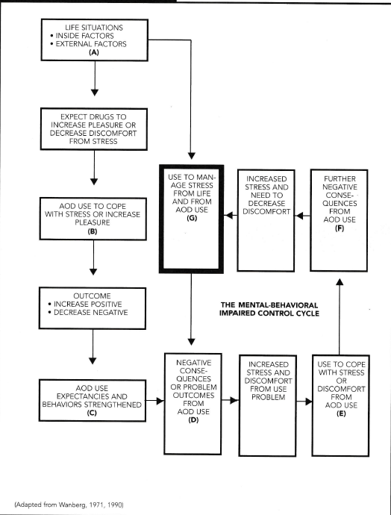
Mental-Behavioral Impaired Control Cycle
Wanberg, K., Milman, H. “Criminal Conduct & Substance Abuse Treatment” 2006

Slide 15
Substance Use Disorder Diagnostic Criteria
Criteria 1-4: Impulse Control
Taking the substance in larger amounts or over a longer period of time than was originally intended
Persistent desire to cut down or regulate substance use and may report multipole unsuccessful efforts to decrease or discontinue use
A great deal of time is spent in activities to obtain, use, or recover from use
Cravings

Slide 16
Substance Use Disorder Diagnostic Criteria
Criteria 5-7: Social Impairment
Recurrent substance use resulting in failure to meet obligations at work, school or home
Continued use despite persistent or recurrent social or interpersonal problems caused by or made worse by use
Important social, occupational or recreational activities given up or reduced because of use

Slide 17
Substance Use Disorder Diagnostic Criteria
Criteria 8-9: Risky Use
Recurrent substance use in situations in which it is physically hazardous
Continued use despite knowledge of having a persistent or recurrent physical or psychological problems caused by or exacerbated by use

Slide 18
Substance Use Disorder Diagnostic Criteria
Criteria 10-11: Pharmacological
Tolerance
Needing increased amounts to achieve intoxication or desired effect
Diminished effect with continued use of the same amount
Withdrawal
Experiencing symptoms (specific to the substance) after cessation of use
Using similar substances to avoid experiencing withdrawal symptoms

Slide 19
Substance Use Disorder Diagnostic Criteria
Severity Rating
Mild: 2-3 symptoms
Moderate: 4-5 symptoms
Sever: 6 or more symptoms

Slide 20
How To Get Help
If you have health insurance, ask for a list of providers
Call and schedule an assessment
Mild forms of Substance Use Disorder can be treated in individual sessions
Explore options with your EAP
Don’t want to go through your employer or insurance; pay out of pocket. Worth the money.
Be open to the idea of therapy, it works

Slide 21
Concerned For a Friend / Co-Worker
Talk about it honestly
Be supportive, but factual
Demonstrate genuine concern

Slide 22
Tips for Vicarious Trauma, Stress, “Burnout”
Team debriefing
Empathize with their struggle, but not by imagining yourself in that situation
Seek out attachment and personal connection with others
Remember: you ARE making a difference
Delegating is not a sin

Slide 23
Exercise
NOT A PROTECTIVE FACTOR FOR TRAUMA, but … As a preventative measure for stress and burnout, this is one of the best things you can do.
Creates a buffer to stress
Improves learning
Increases BDNF
Enhances Neuroplasticity
Improves Mood
Increases focus
…don’t forget to eat healthy

Slide 24
Some Key Take-Aways
Be aware of the difference between “burnout,” Depression, and Vicarious Trauma
Anyone can experience Vicarious Trauma, and it is always significant
Evaluate your coping mechanisms
Ask for help
Use the tips offered for dealing with Vicarious Trauma, Stress, and Burnout

